Slide 1

Real-time Control and Decision-making with Edge
MODULE 3.1

Slide 2
Agenda
Motivation: Systems Under Constraints
The Paradigm Shift to Edge Computing
Defining Real-Time Control
The Environmental Constraints
Intelligent Decision-Making & Offloading
Transitioning to Case Studies
Notebook 01: Slides 9-16
Notebook 02: Slides 17-24
Notebook 03: Slides 25-32
Concluding Remarks

Slide 3

Motivation: Systems Under Constraints
Hardware latency in robotics can destabilize control loops.
Real-world sensor noise creates gaps between simulation and reality.
GenAI traffic bursts often lead to severe GPU congestion.
We need adaptive hybrid systems to handle these variables.

Slide 4

The Paradigm Shift to Edge Computing
Cloud computing introduces unavoidable network latency and bandwidth bottlenecks.
Edge computing pushes processing directly to the data source (sensors, robots, local gateways).
Why it matters: Crucial for applications requiring sub-millisecond reaction times.
Reduces reliance on continuous network connectivity, enabling localized autonomy.

Slide 5

Defining Real-Time Control
Systems that continuously monitor and adjust dynamic environments (e.g., autonomous driving).
Relies on a strict, continuous "Sense → Compute → Act" loop.
The Danger of Latency: Delays in this loop can cause severe system instability or hardware failure.
Traditional physics-based controllers (like PID) are now being augmented by AI for predictive adjustments.

Slide 6
The Environmental Constraints
Compute Limits: Edge devices (e.g., Raspberry Pi, onboard compute) have strict memory and thermal caps.
Sensor Reality: Real-world sensors (LiDAR, telemetry) produce highly noisy, high-variance data compared to simulations.
Network Jitter: Fluctuating network speeds make cloud-reliant control highly unpredictable.
The Solution: AI models must be aggressively optimized (via feature abstraction or quantization) to survive on the edge.

Slide 7
Intelligent Decision-Making & Offloading
Edge compute is limited; not every complex task can or should be processed locally.
Systems must dynamically answer: Compute locally or offload to the cloud?
This decision requires real-time awareness of local GPU load, queue sizes, and network congestion.
The ultimate goal is balancing strict Service Level Agreements (SLAs) against cloud egress costs.

Slide 8
Transitioning to the Case Studies
How do we solve these foundational challenges in practice?
Case 1 (Real-Time Control): Appliances Energy Prediction: Edge AI & Time-Series Forecasting
Case 2 (Edge Robotics): Compressing raw sensor perception into lightweight, real-time motor commands.
Case 3 (Decision-Making): Using neural networks to dynamically route GenAI tasks across a cluster.

Slide 9
NB:01 - Objective: Edge-Style Forecasting
Goal: Build a time-series forecasting pipeline using Ridge Regression, 1D-CNN, and GRU, plus an edge decision agent.
Application: Predict household appliance energy consumption and simulate real-time load shedding via an Edge Controller.
Constraint: Manage dynamic time-series patterns using windowed preprocessing and ensure reliable edge predictions.

Slide 10
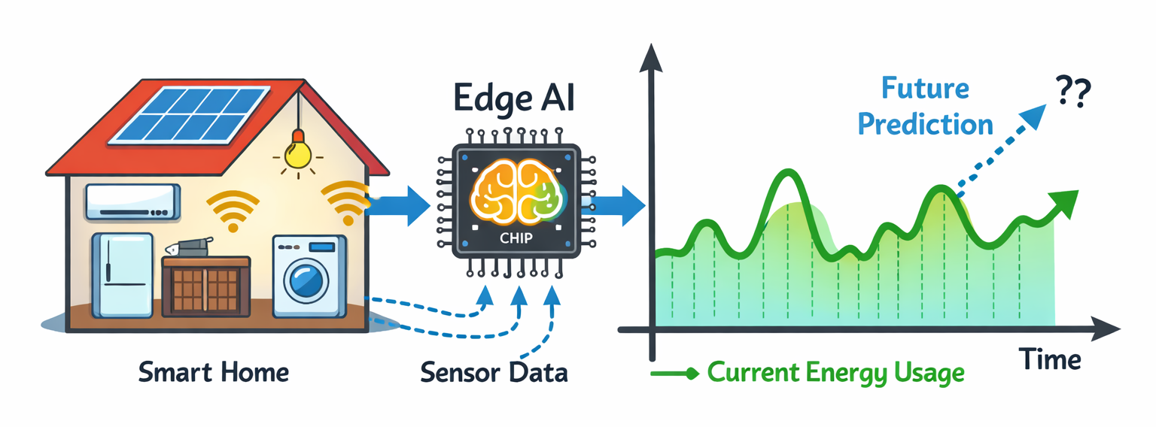
Schematic Diagram
Case Study 01: Schematic Diagram

Slide 11
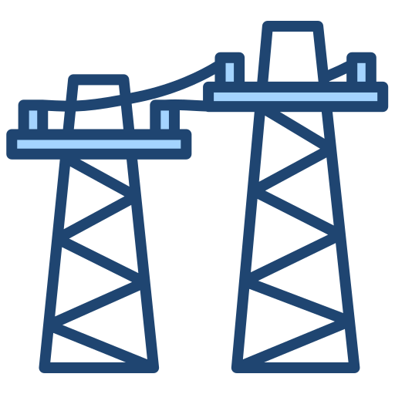
NB:01 - Background
Grid Instability: Residential peak loads are highly volatile and non-linear, threatening local grid stability.
The Latency Gap: Traditional cloud processing is too slow for the sub-second decisions required for real-time load shedding.
Edge Intelligence: An autonomous Edge Controller processes windowed data locally to simulate immediate, reliable load-shedding actions.

Slide 12
NB:01 - Data Preprocessing Strategy
Applied Robust Scaling to reduce impact of spikes and outliers in sensor readings.
Converted tabular telemetry into windowed time-series sequences for temporal learning.
Built a noise-resilient pipeline for stable predictions under volatile appliance usage.

Slide 13
NB:01 - Model Architectures Compared
Ridge Regression (Baseline): Linear benchmark on flattened windows for fast, interpretable predictions.
1D-CNN (Edge Model): Learns local temporal patterns in windowed sequences with efficient inference.
GRU (Sequential Model): Captures longer-term temporal dependencies in energy usage.
Conclusion: GRU delivers the most accurate forecasts, outperforming both the linear baseline and CNN on sequential energy patterns.

Slide 14
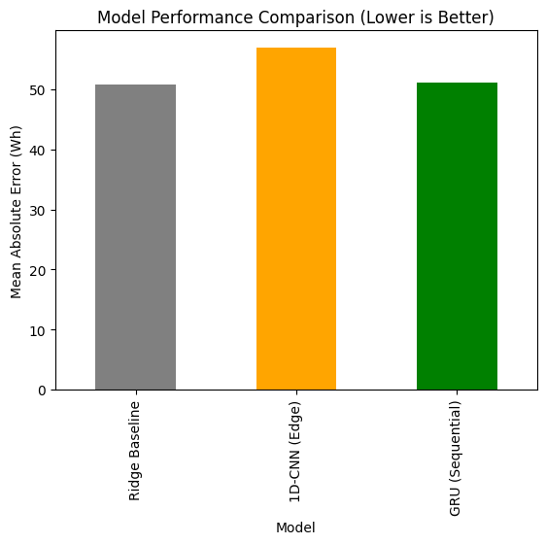
NB:01 - Results and Edge Deployment
GRU demonstrated superior performance in capturing temporal dependencies.

Slide 15
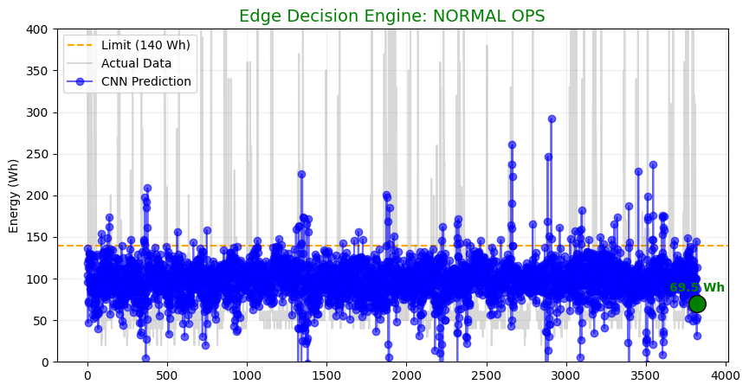
NB:01 - Results and Edge Deployment

Slide 16
NB:01 - Results and Edge Deployment
Conversion of PyTorch models to TorchScript or ONNX.
Target Hardware: Low-power devices like a Raspberry Pi.
Future Work: Adding temporal features like 'hour-of-day' for peak usage.

Slide 17

NB:02 - Objective: Behavioral Cloning
Goal: Train a robot to mimic an 'expert' agent's navigation tasks.
Strategy: Map raw Perception (LiDAR) directly to Action (Motor Control).
Advantage: Replaces brittle manual if-then rules with a fluid neural policy.

Slide 18
NB:02 - Background
Heuristic Rigidity: Traditional "if-then" navigation rules often fail in complex, dynamic environments that the original programmer did not explicitly define.
The Perception-Action Gap: Translating high-dimensional sensor data (like LiDAR) into precise motor commands manually is computationally expensive and error-prone.
Dynamic Obstacle Complexity: Static algorithms struggle to maintain fluid trajectories when faced with unpredictable spatial layouts and moving objects.

Slide 19
NB:02 - Sensor Abstraction (LiDAR)
Raw LiDAR provides 360+ points of high-dimensional, noisy depth data.
Technical Fix: 'Binning' points into spatial cones: Front, Left, and Right.
Benefit: Minimizes noise and reduces computational overhead for the edge.

Slide 20
NB:02 - Robust Data Pipeline
Normalized LiDAR distances (clipped at 5m) to prevent gradient explosion.
Data Splitting: Split by episodes (files) rather than randomized steps.
Why it matters: Prevents the model from memorizing specific room layouts.

Slide 21
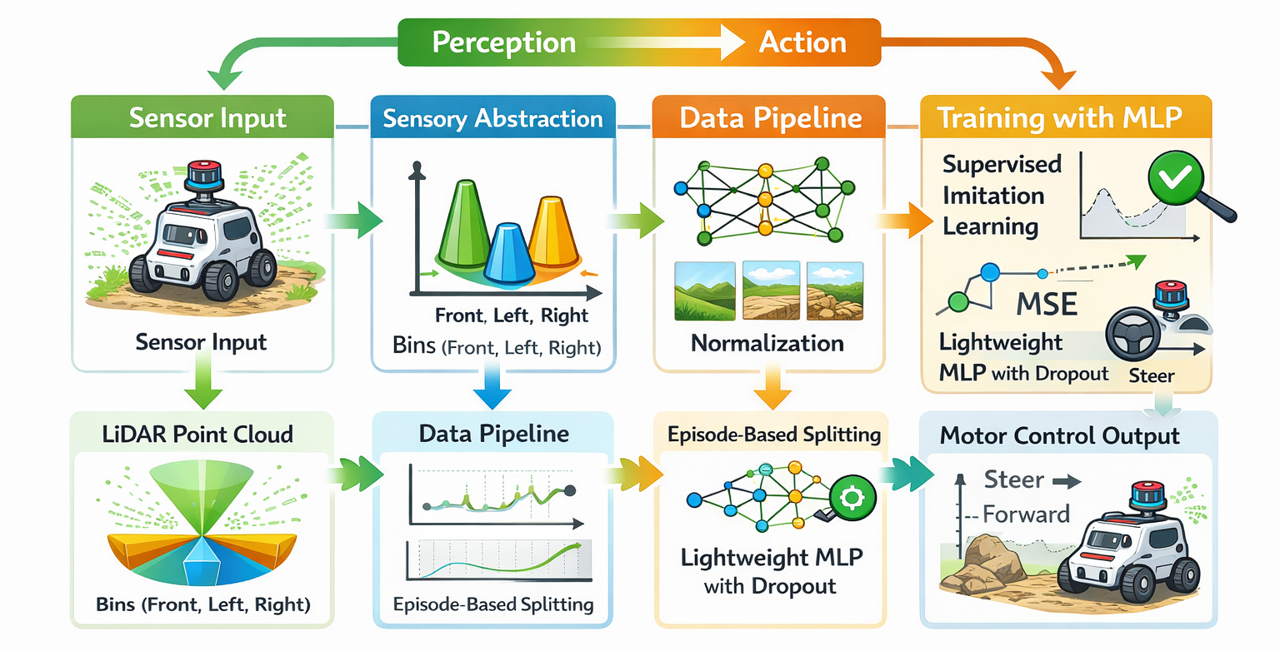
Schematic Diagram
Case Study 02: Schematic Diagram

Slide 22
NB:02 - Baseline MLP Policy
Architecture: Lightweight 3-layer MLP optimized for low-latency embedded execution.
Robustness: Integrated Dropout (0.2) to mitigate stochastic sensor noise and failures.
Objective: Maps 3D inputs to 2D motor commands via Mean Squared Error (MSE) loss.

Slide 23
NB:02 - Residual Learning Policy
Architecture: Deep feature extractor utilizing Skip Connections to prevent signal degradation.
Stability: Employs Batch Normalization to handle varied sensor dynamic ranges.
Performance: Projects input to a 64-feature manifold for complex obstacle negotiation.

Slide 24
NB:02 - Validation Outcomes
Evaluated overall performance using RMSE analysis of predicted actions.
Behavioral Visualization: Verified obstacles result in correct maneuvers.
Confirmed driving consistency across smooth floors and rough surfaces.

Slide 25
NB:03 - Objective: Neural Policy Network
Goal: Decide if an inference task should be processed Locally or Offloaded.
Decision Factors: Real-time network congestion and local GPU availability.
Focus: Managing bursty GenAI workloads in hybrid environments.

Slide 26
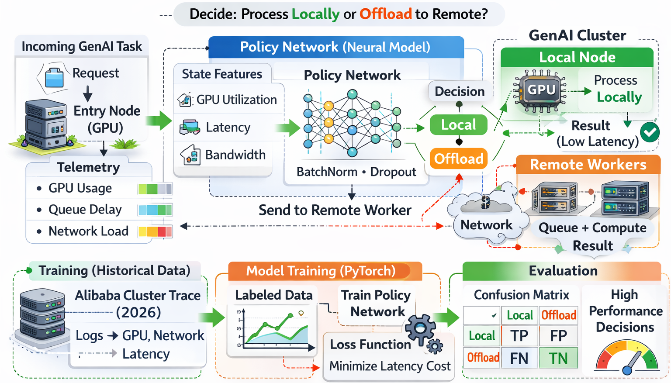
Case Study 03: Schematic Diagram

Slide 27
NB:03 - Background
Resource Constraints: Mobile and edge devices often lack the memory and compute power required to handle large-scale Generative AI (GenAI) workloads locally.
Bursty Workloads: AI inference requests are often unpredictable and non-uniform, leading to sudden "bursts" that can overwhelm local hardware.
Network Volatility: Relying entirely on the cloud introduces latency risks due to real-time network congestion and varying bandwidth.

Slide 28
NB:03 - Real-World Telemetry
Utilized authentic production logs (Alibaba Cluster Trace 2026).
Key Inputs: Inference Latency, Queue Response Time, and GPU Duty Cycle.
Allowed the model to learn from hardware behavior and network jitter.

Slide 29
NB:03 - Solving Class Imbalance
Pitfall: Infrastructure data is often biased toward one decision (e.g., local).
Fix: Implemented Median-Based Cost Scoring for a balanced boundary.
Logic: Label 1 if cost > median (Congested), Label 0 if cost < median (Efficient).

Slide 30

NB:03 - Offloading Strategy Model
Architecture: Hybrid PyTorch network utilizing BatchNorm and Dropout for stability.
Goal: Predicts the optimal execution venue (Local vs. Cloud) to minimize total latency.
Adaptability: Engineered for real-time response to dynamic network traffic spikes.

Slide 31
NB:03 - Neural vs. Classical Baselines
ML Baselines: Compared against Logistic Regression and Random Forest (100 trees).
Neural Baseline: Benchmarked with a Simple MLP (16-unit hidden layer) to justify complexity.
Evaluation: Models validated using Cross-Entropy Loss and Confusion Matrices for offloading accuracy.

Slide 32
NB:03 - Infrastructure Stability
Utilized Confusion Matrices to identify critical system failure states.
False Locals: Processing locally during queue backups, causing SLA violations.
False Offloads: Sending to cloud when GPU is free, causing egress costs.

Slide 33
Technical Comparison of Case Studies
Feature | NB:01 (Energy Forecasting) | NB:02 (Imitation Learning) | NB:03 (Cluster Offloading)
Primary Goal | Time-series prediction | Sensor-to-Action mapping | Resource Scheduling
Input Data | Power Telemetry (Amps/Volts) | Binned LiDAR (3 Cones) | Cluster Logs (GPU/Network)
Model Type | Sequential (GRU / CNN) | Lightweight MLP | Neural Policy Network
Optimization | Temporal Trends | Behavior Mimicry | Latency vs. Egress Cost
Edge Constraint | Power spikes & Outliers | Real-time motor latency | SLA & Traffic Bursts

Slide 34
Unified Technical Theme
Central Theme: Intelligent decision-making under hardware constraints.
Robotics (NB:02): Focused on low-latency edge control.
Distributed Systems (NB:03): Focused on throughput optimization and SLAs.

Slide 35
Key Performance Lessons
Feature abstraction (LiDAR binning) is non-negotiable for the edge.
Data-driven neural policies consistently outperform static schedulers.
Robust preprocessing is essential when dealing with noisy physical sensors.

Slide 36

Future Directions
Deployment: Transitioning to edge hardware via TorchScript/ONNX.
Feature Engineering: Enhancing forecasting with temporal metadata.
Bridging the gap by training on noisy physical sensor data.

